Slide 1

jMIR Overview
Cory McKay
Marianopolis College and CIRMMT
Montreal, Canada

Slide 2
Lecture contents
Introduction to automatic music classification
Introduction to the jMIR software
The jMIR components
One by one
Paper ideas
Previous collaborations

Slide 3
Goal of automatic music classification
Learn some way of mapping “features” extracted from an “instance” to one or more “classes”
Instance: an item to be classified
e.g. a song
Features: representative information extracted from an instance
e.g. amount or chromatic motion in a song
Class: a category of interest
e.g. a genre, mood, artist, composer, instrument, etc.
Ideally organized into some kind of class ontology
This mapping is typically learned using some form of pattern recognition and machine learning

Slide 4
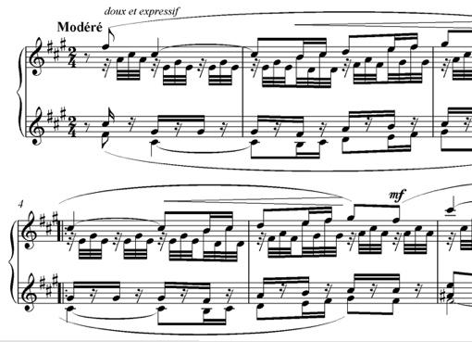
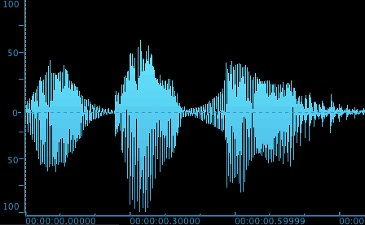

Main sources of information
Symbolic recordings
e.g. MIDI
Audio recordings
e.g. MP3
Cultural data
e.g. web data, listener statistics, metadata tags, etc.
Lyrics
Others
Album art, videos, etc.

Slide 5
Automatic music classification
Typical procedure:
Collect annotated training / testing data
Extract features
Reduce feature dimensionality
Train a classification model
Typically supervised
Validate the model
Some significant challenges:
Acquiring a sufficiently large dataset with sufficiently high-quality annotations
Designing features that encapsulate the relevant data

Slide 6
Overview of the jMIR software
jMIR is software suite designed for performing research in automatic music classification
Primary tasks performed:
Dataset management
Acquiring, cleaning and organizing metadata
Feature extraction
Machine learning
Data storage file formats

Slide 7
Some characteristics of jMIR
Has a separate software component to address each important aspect of automatic music classification
Each component can be used independently
jMIR can also be used as an integrated whole
Free and open source
Architectural emphasis on providing an extensible platform for iteratively developing new techniques and algorithms
Interfaces designed for both technical and non-technical users
Facilitates multimodal research

Slide 8
jMIR components
8/41
jAudio: Audio feature extraction
jSymbolic: Feature extraction from MIDI files
jWebMiner: Cultural feature extraction
jLyrics: Extracts features from lyrical transcriptions
ACE: Meta-learning classification engine
ACE XML: File formats
Features, feature metadata, instance metadata and ontologies
lyricFetcher: Lyric mining
Codaich, Bodhidharma MIDI and SLAC: datasets
jSongMiner: Metadata harvesting
jMusicMetaManager: Metadata management
jMIRUtilities: Infrastructure for conducting experiments
jProductionCritic: Detects technical production errors

Slide 9
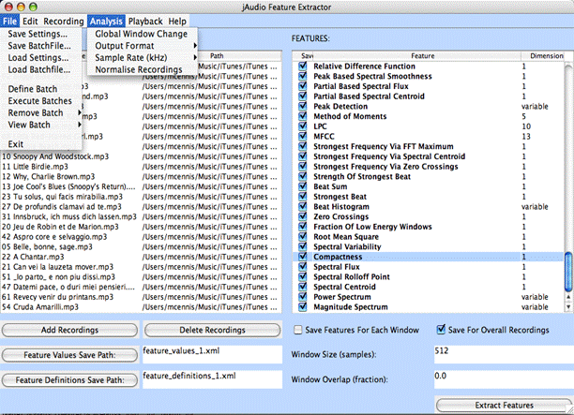
jAudio: Audio feature extractor
Extracts features from audio files
MP3, WAV, AIFF, AU, SND, etc.
28 bundled core features
Mainly low-level, some high-level
Can automatically generate new features using metafeatures and aggregators
e.g. the change in a feature value from window to window
Includes tools for testing new features being developed
Synthesize audio, record audio, sonify MIDI, display audio, etc.

Slide 10
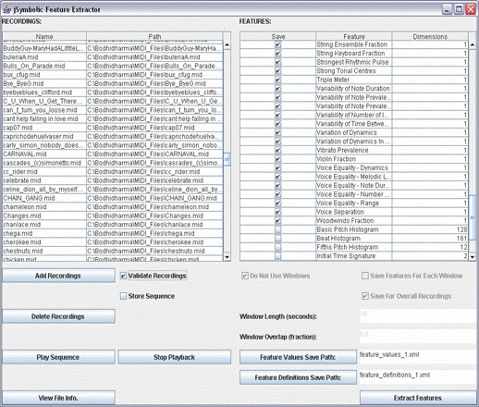
jSymbolic: Symbolic feature extractor
Extracts features from MIDI files
111 implemented features
By far the largest existing symbolic feature catalogue
Many are original
An additional 49 features are proposed but not yet implemented

Slide 11
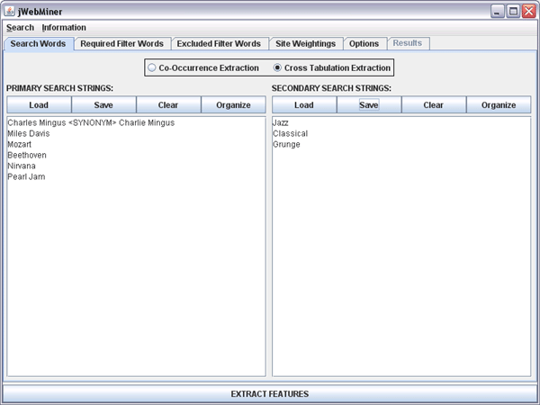
jWebMiner: Cultural feature extractor
Extracts cultural features from the web using search engine web services
Calculates how often particular strings co-occur on the same web pages
e.g. how often does “J. S. Bach” co-occur on a web page with “Baroque”, compared to “Prokofiev”?
Results are processed to remove noise
Additional options:
Can assign weights to particular sites
Can enforce filter words
Permits synonyms
Also calculates features based on Last.FM user tags frequencies

Slide 12
lyricFetcher: Lyric miner
lyricFetcher automatically harvests lyrics from on-line lyrics repositories
LyricWiki and LyricsFly
Queries based on lists of song titles and artist names
Post-processing is applied to the lyrics in order to remove noise and make them sufficiently consistent for feature extraction
Deals with situations where sections of lyrics are abridged using keywords such as “chorus”, “bridge”, “verse”, etc.
Filters out keywords that could contaminate the lyrics

Slide 13
jLyrics: Lyrical feature extractor
Extracts features from lyrics stored in text files:
Automated Readability Index Number of Segments
Average Syllable Count Per Word Number of Words
Contains Words Part-of-Speech Frequencies
Flesh-Kincaid Grade Level Punctuation Frequencies
Flesh Reading Ease Rate of Misspelling
Function Word Frequencies Sentence Count
Letter-Bigram Components Sentence Length Average
Letter Frequencies Topic Membership Probabilities
Letters Per Word Average Vocabulary Richness
Letters Per Word Variance Vocabulary Size
Lines Per Segment Average Word Profile Match
Lines Per Segment Variance Words Per Line Average
Number of Lines Words Per Line Variance
Can also automatically generate word frequency profiles for particular classes of training data is provided

Slide 14
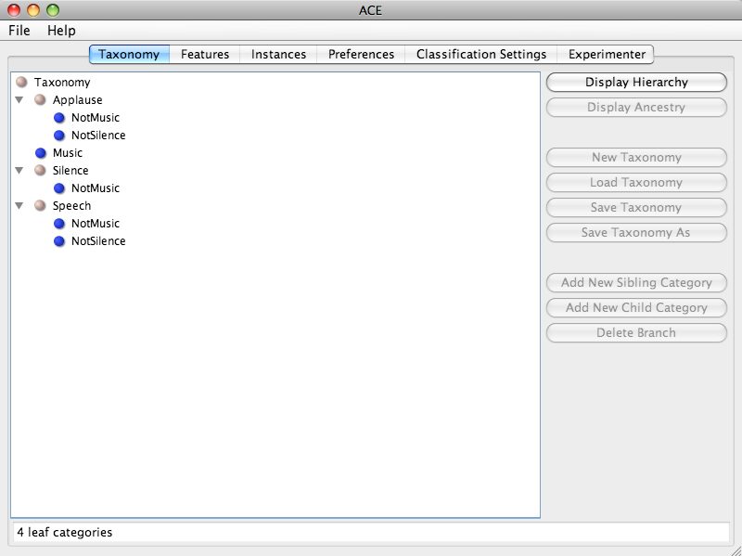
ACE: Meta-learning engine
Evaluates the relative suitability of different dimensionality reduction and classification algorithms for a given problem
Can also train and classify with manually selected algorithms
Evaluates algorithms in terms of
Classification accuracy
Consistency
Time complexity
Based on the Weka framework, so new algorithms can be added easily

Slide 15
jMIR datasets
Codaich is an MP3 research set
Carefully cleaned and labelled
The published 2006 version has 26,420 recordings
Belonging to 55 genres
Is constantly growing: currently over 45,000 MP3s
Bodhidharma MIDI has 950 MIDI recordings
38 genres of music
SLAC consists of 250 matched audio recordings, MIDI recordings, lyrical transcriptions and metadata that can be used to extract cultural features
Useful for experiments on combining features from different types of data
10 genres of music (in 5 pairs of similar genres)

Slide 16
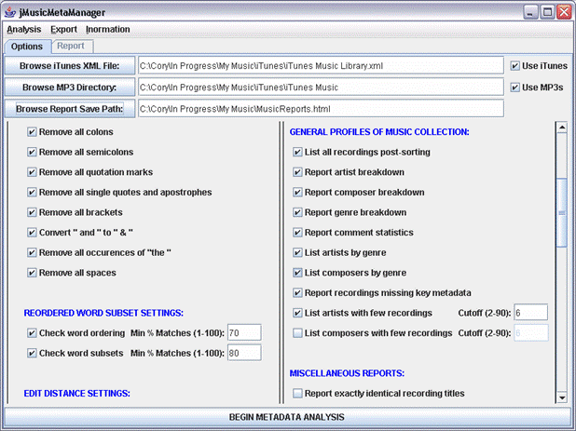
jMusicMetaManager: Dataset manager
Detects metadata errors/inconsistencies and redundant copies of recordings
Detects differing metadata values that should in fact be the same
e.g. “Charlie Mingus” vs. “Mingus, Charles”
Generates HTML inventory and profile reports
39 reports in all
Parses metadata from ID3 tags and iTunes XML

Slide 17
jSongMiner: Metadata miner
Software for automatically acquiring formatted metadata about songs, artists and albums
Designed for use with the Greenstone digital library software
May also be used for other purposes, such as cultural feature extraction
Identifies music files
Uses Echo Nest fingerprinting functionality and embedded metadata
Mines a wide range of metadata tags from the Internet and collates them in a standardized way
Data extracted from The Echo Nest, Last.FM, MusicBrainz, etc.
Over 100 different fields are extracted
Data may be formatted into unqualified and/or qualified Dublin Core fields if desired
Saves the results in ACE XML or text
Can also be integrated automatically into a Greenstone collection

Slide 18
ACE XML: MIR research file formats
Standardized file formats that can represent:
Feature values extracted from instances
Abstract feature descriptions and parameterizations
Instance labels and annotations
Class ontologies
Designed to be flexible and extensible
Able to express types of information that are particularly pertinent to music
Allow jMIR components to communicate with each other
Can also be adopted for independent use by other software
ACE XML 2.0 provides even more expressivity
e.g. potential for integration into RDF ontologies

Slide 19
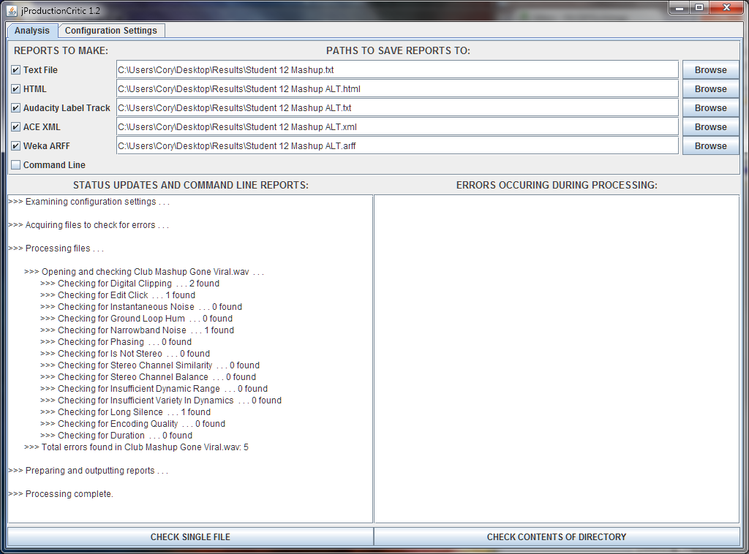
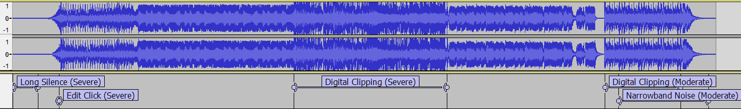
jProductionCritic
What is it?
Educational software for automatically detecting sound recording and production errors in audio tracks
Who is it for?
Students
Professors and markers
Amateur (and professional?) producers

Slide 20
(Some) past collaborations (1/2)
Jason Leung (2014)
Automatic assessment of violin tone quality
Julian Vogels (2013)
A Processing application for visualizing ACE XML data
github.com/julianvogels/jMIR-visualization
Vigliensoni, McKay and Fujinaga (2010)
Addition of Last.FM functionality to jWebMiner
Empirical comparison of different kinds of cultural data
Angeles, McKay and Fujinaga (2010)
Addition of MusicBrainz functionality to jMusicMetaManager
Empirical comparison of curated, noisy and automatically cleaned metadata
McKay, Burgoyne, Hockman, Smith, Vigliensoni and Fujinaga (2010)
Development of jLyrics and lyricFetcher
Empirical comparison of different feature types

Slide 21
(Some) past collaborations (2/2)
Thompson, McKay, Burgoyne and Fujinaga (2009)
Improvements to ACE
McKay, Burgoyne, Thompson and Fujinaga (2009)
Improvements to ACE XML
McEnnis, McKay and Fujinaga (2006)
Improvements to jAudio
Fiebrink, McKay and Fujinaga (2005)
An empirical investigation of dimensionality reduction using ACE (and other technologies)
Sinyor, McKay, Fiebrink, McEnnis and Fujinaga (2005)
Beatboxing classification using ACE and jAudio

Slide 22
Paper ideas: Improve components
jSymbolic
Develop more features or implement the remaining feature catalogue
jAudio
Develop more features, especially perceptually meaningful features
Improve interface
A few buggy features to fix
jProductionCritic
Add qualitative evaluations
jSongMiner
Add more data sources
jWebminer
Add web services (e.g. Amazon) and add more features
jLyrics
Develop features especially relevant to music
ACE
Add more machine learning algorithms
Especially unsupervised learning
jMusicMetaManager
Add correction functionality

Slide 23
Paper ideas: Develop new components
OMEN
Reimplement and get working
jImage
Extract features from album art, press photos, etc.
jVideo
Extract features from music videos, concert videos, etc.
jMusicVisualiser
Offer visual ways of exploring relationships between musical instances, features and classes
jStructure:
Automatically segment audio streams in time, both in terms of partitioning separate pieces of music within a single stream and in terms of structural divisions within individual pieces
jClassOntology
Use data mining to harvest class ontologies

Slide 24
Paper ideas: Update web services
Web services get deprecated and replaced, and applications using them need to be updated
jWebMiner
jSongMiner
lyricFetcher
And new web services can be added

Slide 25
Paper ideas: Apply jMIR
There are many problems to which the jMIR components could be applied
Either directly or with specialized improvements (e.g. features developed especially for chord recognition)
Consider the many MIREX application areas
www.music-ir.org/mirex/wiki/MIREX_HOME
More ideas:
See the Future Research sections of my papers and dissertation

Slide 26
More information
Overview, documentation and publications
jmir.sourceforge.net
Code and (in most cases) manuals
sourceforge.net/projects/jmir/
sourceforge.net/projects/jaudio/
My dissertation on jMIR
www.music.mcgill.ca/~cmckay/papers/musictech/mckay10dissertation.pdf
Other jMIR-related publications can also be found on my web page: www.music.mcgill.ca/~cmckay/
E-mail
cory.mckay@mail.mcgill.ca

Slide 27




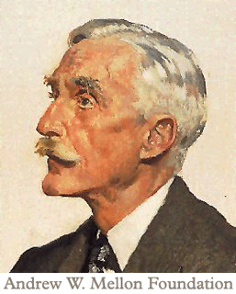
Acknowledgements
Collaborators at McGill and Waikato Universities
Funding, past and present:
CIRMMT
Fonds de recherche sur la société et la culture
Social Sciences and Humanities Research Council of Canada
Centre for Open Software Innovation
Andrew W. Mellon Foundation
Canadian Foundation for Innovation
Contact information:
jmir.sourceforge.net
cory.mckay@mail.mcgill.ca

